Slide 1

Object Oriented Design and Programming
Week 11
Version 2 – 18th December 2015

Slide 2
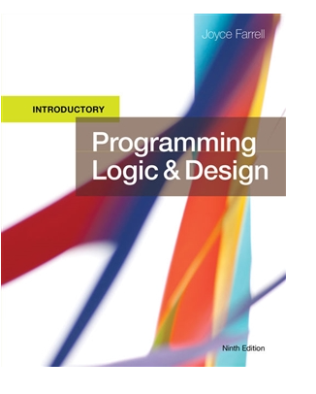
SLIDE TITLE
Farrell, J. (2017) Programming Logic and Design, Comprehensive (9th ed.) Cengage Learning

Slide 3
Programming Logic and Design
Array of Objects

Slide 4
Arrays
We used an Array for the first assignment and have stored basic data types.
An array is a collection that can store items of the same data type (eg all int values or all Student marks)
Accessed using an index or subscript
Size set at creation

Slide 5
Arrays Revision
Arrays are groups of elements of the same data type
One name is used to refer to the entire group
Individual elements in the group have an index that begins at 0 in Java.
So, what do each of the following lines of code do?
int[] studentMarks;
studentMarks = new int[200];
studentMarks[0] = 85;

Slide 6
Array of Objects
An array of objects is created just like an array of primitive type data items in the following way. Student[] studentArray = new Student[7];
The above statement creates the array which can hold references to seven Student objects.

Slide 7
Students Array
The line on previous slide doesn't create the Student objects themselves.
They must be created separately using the constructor of the Student class.
The studentArray contains seven memory spaces in which the address of seven Student objects may be stored.
If we try to access the Student objects even before creating them, run time errors would occur. For instance, the following statement throws a NullPointerException during runtime which indicates that studentArray[0] isn't yet pointing to a Student object.

Slide 8
Students Array
The Student objects must be instantiated using the constructor of the Student class and their references should be assigned to the array elements in the following way.
studentArray[0] = new Student();
In this way, we create the other Student objects also.

Slide 9
Students Array
If each of the Student objects have to be created using a different constructor, we use a statement similar to the above several times.
However, in this particular case, we may use a for loop since all Student objects are created with the same default constructor.
for ( int i=0; i<studentArray.length; i++) { studentArray[i]=new Student(); }

Slide 10
Array of Objects
Consider these two classes
Course
- courseNumber: String - courseName: String - students: Student[ ] - maximumEnrolment: int - numEnrolled: int
+ Course() + Course(courseName: String,courseNumber: String, maximumEnrolment:int) + getCourseName(): String + setCourseName(newName: String): void + getCourseNumber(): String + setCourseNumber(newNumber: String): void + addStudent(aStudent: Student): void + getStudentAt(index: int): Student + numberEnrolled(): int + displayAllStudents(): void + toString(): String
Student
- studentNumber: String - name: String
+ Student(String,String) + Student() + getName(): String + setName(newName: String): void + getStudentNumber(): String + setStudentNumber(newNumber: String): void + toString(): String
1
1-n

Slide 11
Array of Objects
Course class is having array of type Students.
Create these two classes in eclipse.
For your reference, download student.java and course.java from moodle.
Some methods are already given. Try to understand them.
After creating both classes, download test.java and complete that class.

Slide 12
ArrayList of Objects
Recalling the ArrayList Creation
ArrayList<Type> arrayList= new ArrayList<>();
ArrayList<Type> arrayList= new ArrayList<>(15);
<Type> represents the type of elements of arrayList. For example:
ArrayList <Integer> list= new ArrayList<>();
ArrayList <String> list= new ArrayList<>();
ArrayList<Student> studentList=new ArrayList<>();

Slide 13
Operations on ArrayList
You can perform all operations on objects that were discussed in week 8 lecture which are as follows:
Adding an item into ArrayList - Checking if list is empty
Accessing an item - Checking for an element
Change the item - Checking the index of an element
Remove the item
Size of ArrayList
Looping through ArrayList

Slide 14
Spend rest of your class time on your assessment

Slide 15

kent.edu.au Kent Institute Australia Pty. Ltd. ABN 49 003 577 302 ● CRICOS Code: 00161E ● RTO Code: 90458 ● TEQSA Provider Number: PRV12051

